Slide 1

CUSTOMER SEGMENTATION WITH MACHINE LEARNING
JIGYASU SINGH

Slide 2
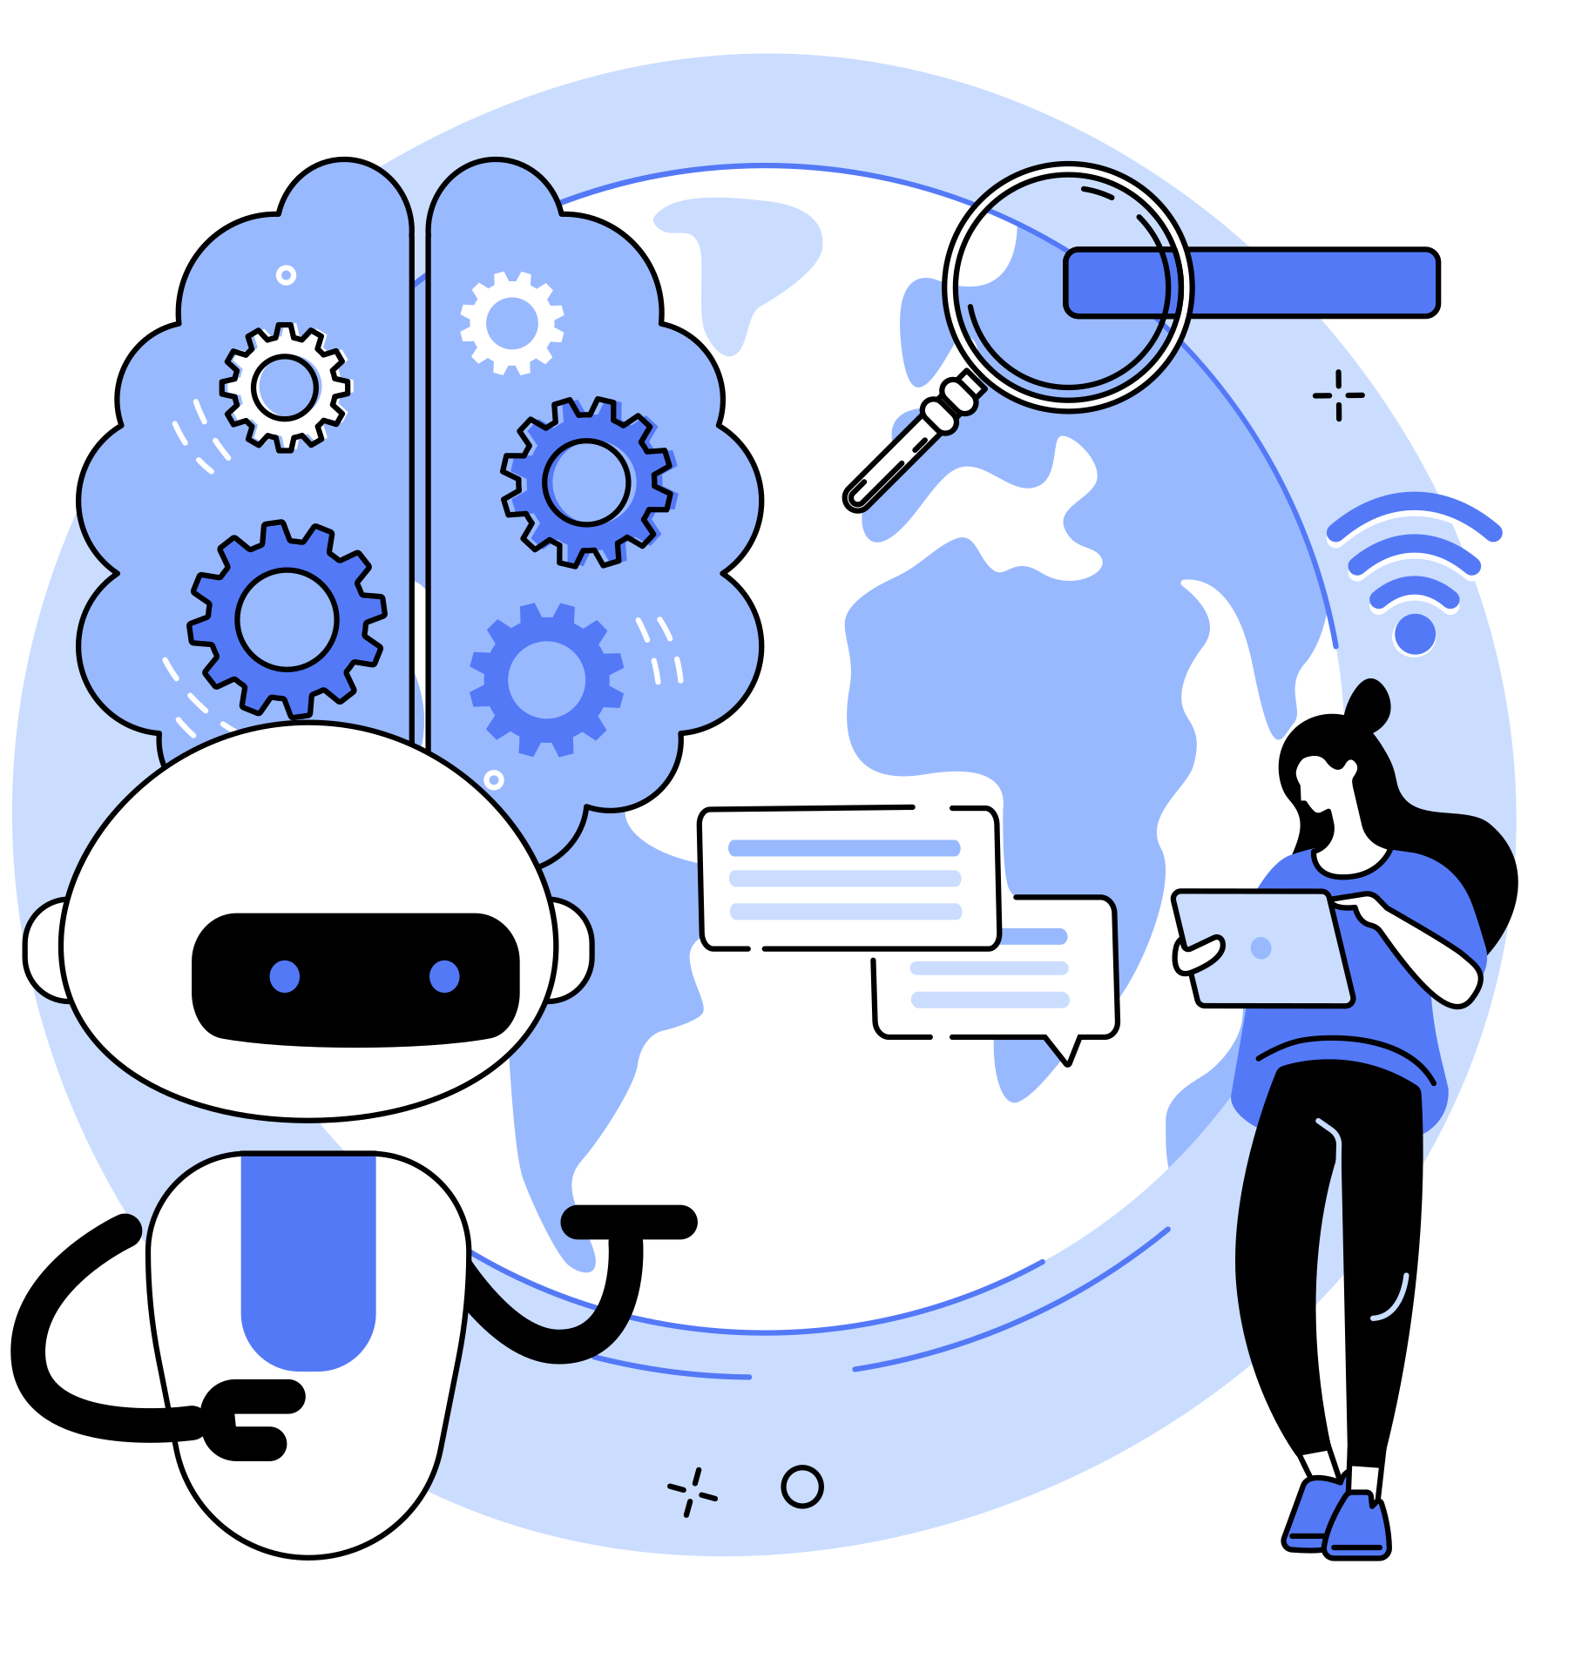
Contents
1
Introduction
2
Business Case
3
Data Preparation
4
K-Means Clustering
5
Overall Strategy

Slide 3

What is Machine Learning?
Machine Learning (MI) iMachine Learning is a subset of artificial intelligence that enables systems to automatically learn and improve from experience without being explicitly programmed.

Slide 4
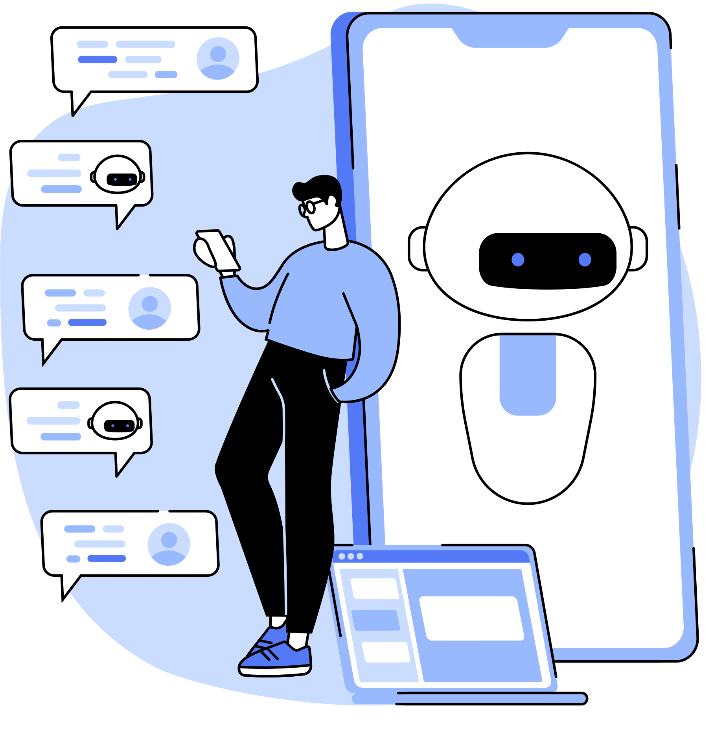
Customer Segmentation with K-Means
Leveraging machine learning for personalized relationships
Focus on customer behavior: Products,
return rate, spending
Objective: Tailor strategies based on distinct customer segments

Slide 5

Business Case
In our quest for maximizing customer engagement and satisfaction, we pose a fundamental question: Can the customer base be effectively grouped? The solution lies in the strategic application of customer segmentation through behavioral analysis. By delving into crucial aspects such as the number of products ordered, return rate, and spending habits, we aim to tailor relationships and experiences for each customer segment. This business case underscores the significance of understanding and leveraging customer behavior to foster customized relationships, ultimately enhancing overall business performance.

Slide 6
Data Preparation
25,000 Unique Customers
Dataset includes a diverse range of 25,000 individual customers.
Features
Key Features Considered:
Products Ordered
Return Rate
Total Spending
Preparation for Visualization and Explainability
Calculated features essential for segmentation.
Sets the groundwork for effective visualization and algorithm explainability.

Slide 7
Data Preparation
25,000 Unique Customers
Dataset includes a diverse range of 25,000 individual customers.
Features
Key Features Considered:
Products Ordered
Return Rate
Total Spending
Preparation for Visualization and Explainability
Calculated features essential for segmentation.
Sets the groundwork for effective visualization and algorithm explainability.

Slide 8
K-Means Clustering
Initialization
Assignment
Center Movement
Hyperparameter Tuning: Selecting Optimal Clusters (k)
Data points are assigned to the nearest centroid based on Euclidean distance.
Forms clusters based on similarities in the dataset.
Random or smart initialization of centroids (cluster centers).
Crucial for the convergence and effectiveness of the algorithm.
Centroids move to the average of all points in the cluster.
Iterative process, repeating assignment and movement until convergence.
Determining the number of clusters is crucial.
Utilizes the elbow method to find the optimal value for k.

Slide 9
Overall Strategy
Preserve Green Group
Improve Blue Group
Engage Red and Purple Groups
Optimize Overall Customer Experience:
Characteristics: High spending, low return rates.
Characteristics: Newcomers, low spending
Characteristics: Brand-aware, multiple product orders
Approach: Continuously analyze and adapt
Key Takeaway
Customization for Success
Next Steps
Tailor strategies to each distinct customer segment.
Maximize engagement, minimize returns, enhance overall satisfaction.
Execute tailored strategies.
Continuously analyze and adjust based on customer response and market trends.

Slide 10

Conclusion
Maximizing Revenue and Satisfaction
Tailoring strategies based on customer behavior enhances customer satisfaction and increases revenue.
Importance of Unsupervised Machine Learning
Utilizing K-Means clustering demonstrates the power of unsupervised machine learning in extracting meaningful patterns from data.
Key Takeaways
Customized relationships through segmentation
Strategic optimization for different customer groups
Unleashing the potential of machine learning for business success

Slide 11
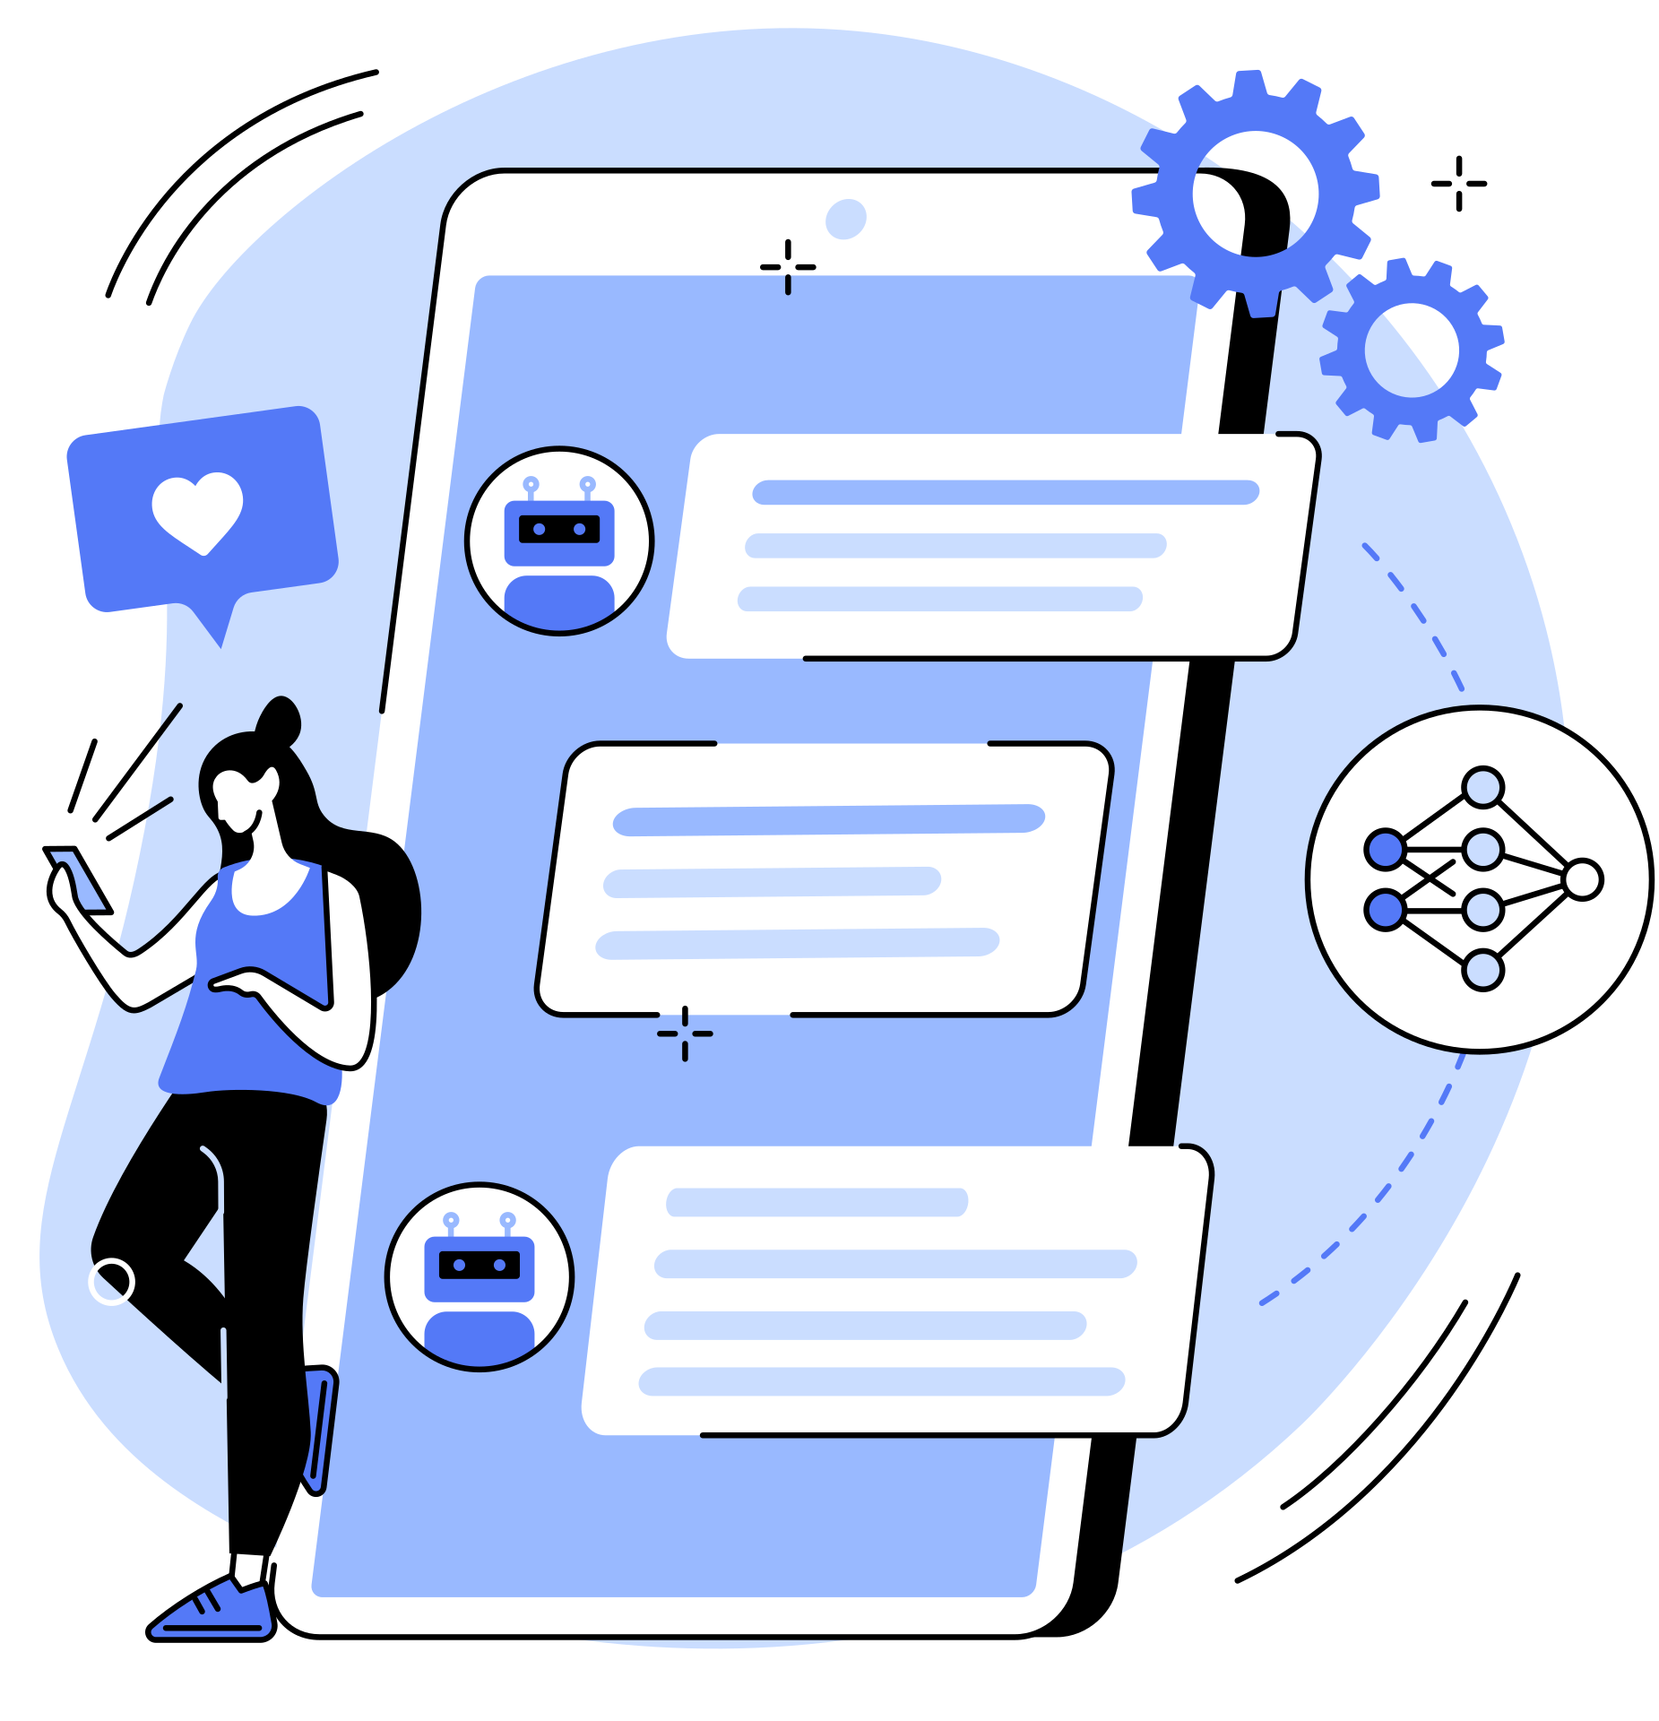
THANK YOU FOR LISTENING!

